Slide 1
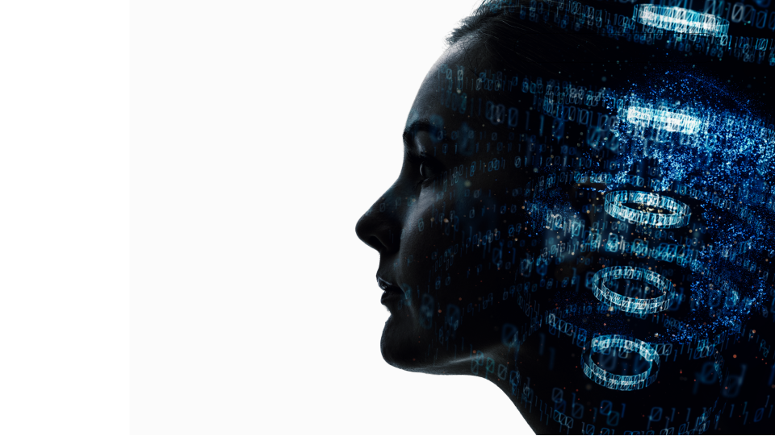


Project no.
Project Proposal
Title: Black Clover
Bryan S. Raguine
Powered by

Slide 2


Project Description
Briefly introduce the project
Black Clover (Japanese: ブラバー, Hepburn: Burakku Kurōbā) is a Japanese manga series written and illustrated by Yūki Tabata.
It has been serialized in Shueisha’s shonen manga magazine weekly Weekly Shōnen Jump since February 2015, with its chapters collected in 35 tankōbon volumes as of June 2023. The story follows Asta, a young boy born without any magic power. This is unknown to the world he lives in because seemingly everyone has some sort of magic power. With his fellow mages from the Black Bulls, Asta plans to become the next Wizard King.
Powered by

Slide 3
Who is the target end user?
What are the objectives?
Any gender and ages. Anime’s feat different genre's that targeting each person appeal taste.
for example some people love in romantic , comedy so they can manage to put them self in the anime they watch.. so each episode they watch there into the scenes affected also their emotion.. some are excited, laugh, angry.. or wish they are the character of that anime..
and in the end.. people watch anime have there own collections or favorites of anime that they watch all over again..
The story focuses on Asta, a young orphan who was raised at a church in Hage Village after being abandoned as a baby. He was raised alongside Yuno, another orphan baby who was left at the church’s doorstep.
In a world where everyone can use Mana, Yuno can wield strong wind magic whereas Asta is born without any magical abilities. Refusing to let this disability get the better of him, Asta puts his body through vigorous physical training hoping to awaken his magical powers.
The series follows the exciting and unpredictable journey of both boys as they work hard towards their goal of becoming the next Magic Emperor.
Powered by

Slide 4
The characters introduced to us in Black Clover are simply amazing and so is their relationship with one another. The friendly rivalry between Asta and Yuno is a joy to watch as their personalities and abilities develop throughout the series.
Define Deliverables and Goals
Present the project timeline
Set goals that align with the deliverables you’re producing
Research 1-2 Days
Planning 1-3 days
Designing 2-3 Days
Coding 4-8 Days
Testing ½ Day
Presentation ½ Day
Powered by

Slide 5
Hierarchical Sitemap of your Website
Information architecture of a website
Visual representation of the site’s organization and how different sections are linked together.
Black clover
NEW EPISODE
NEW AND
OLD MOVIES
CHARACTER
VOICE CHARACTER
HOME
ARTICLE
EVENT
SIGNUP
EVENT

Slide 6

Black clover

